Slide 1

AURORA ASSURANCE LTD By Faith Ejele

Slide 2
AURORA ASSURANCE LTD
FRAUD INTELLIGENCE REPORT

Slide 3
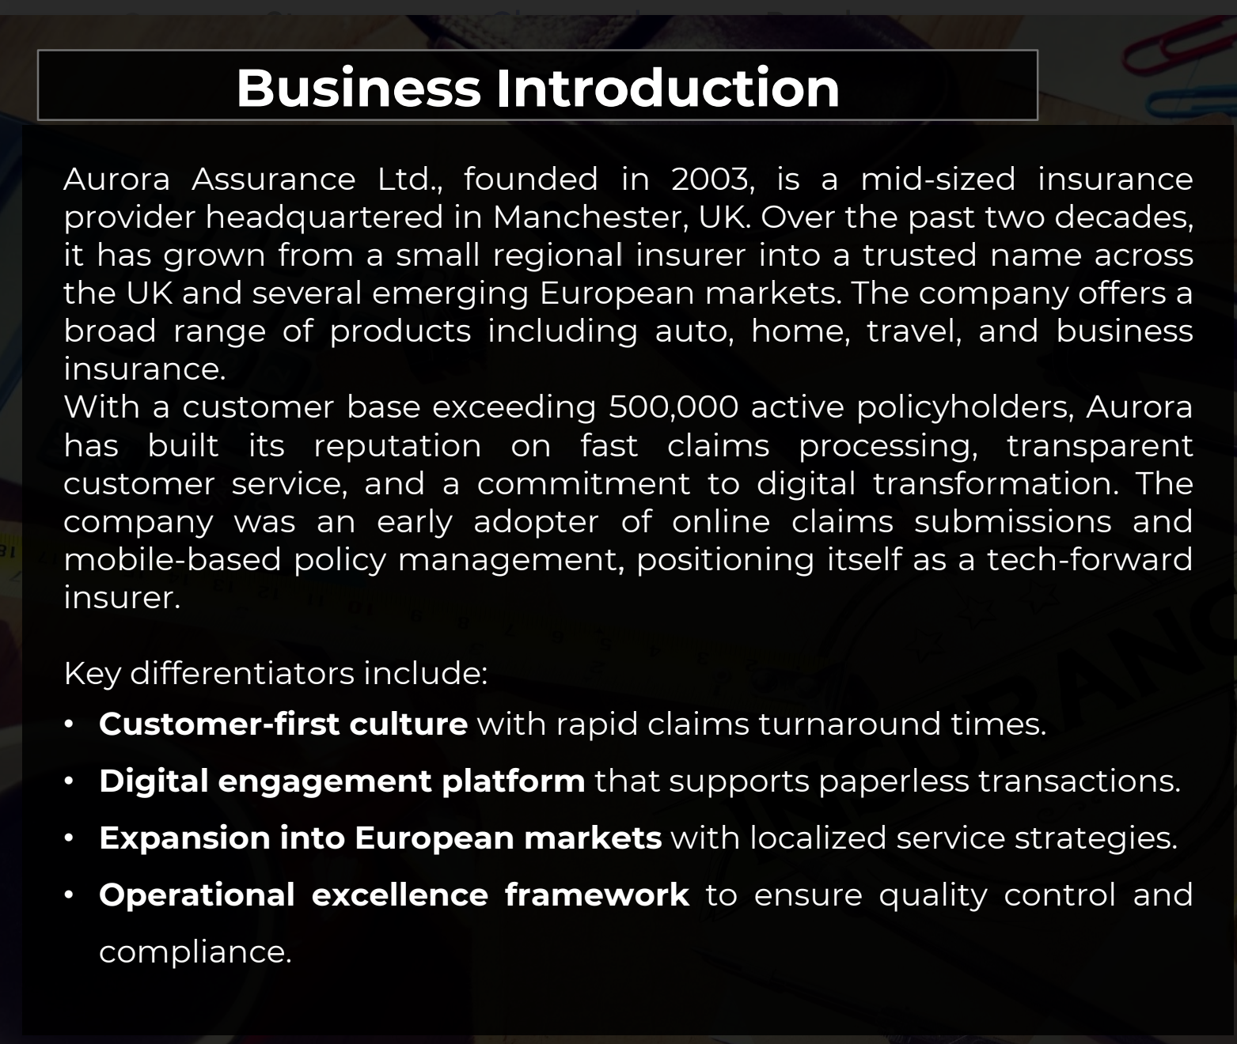

Slide 4
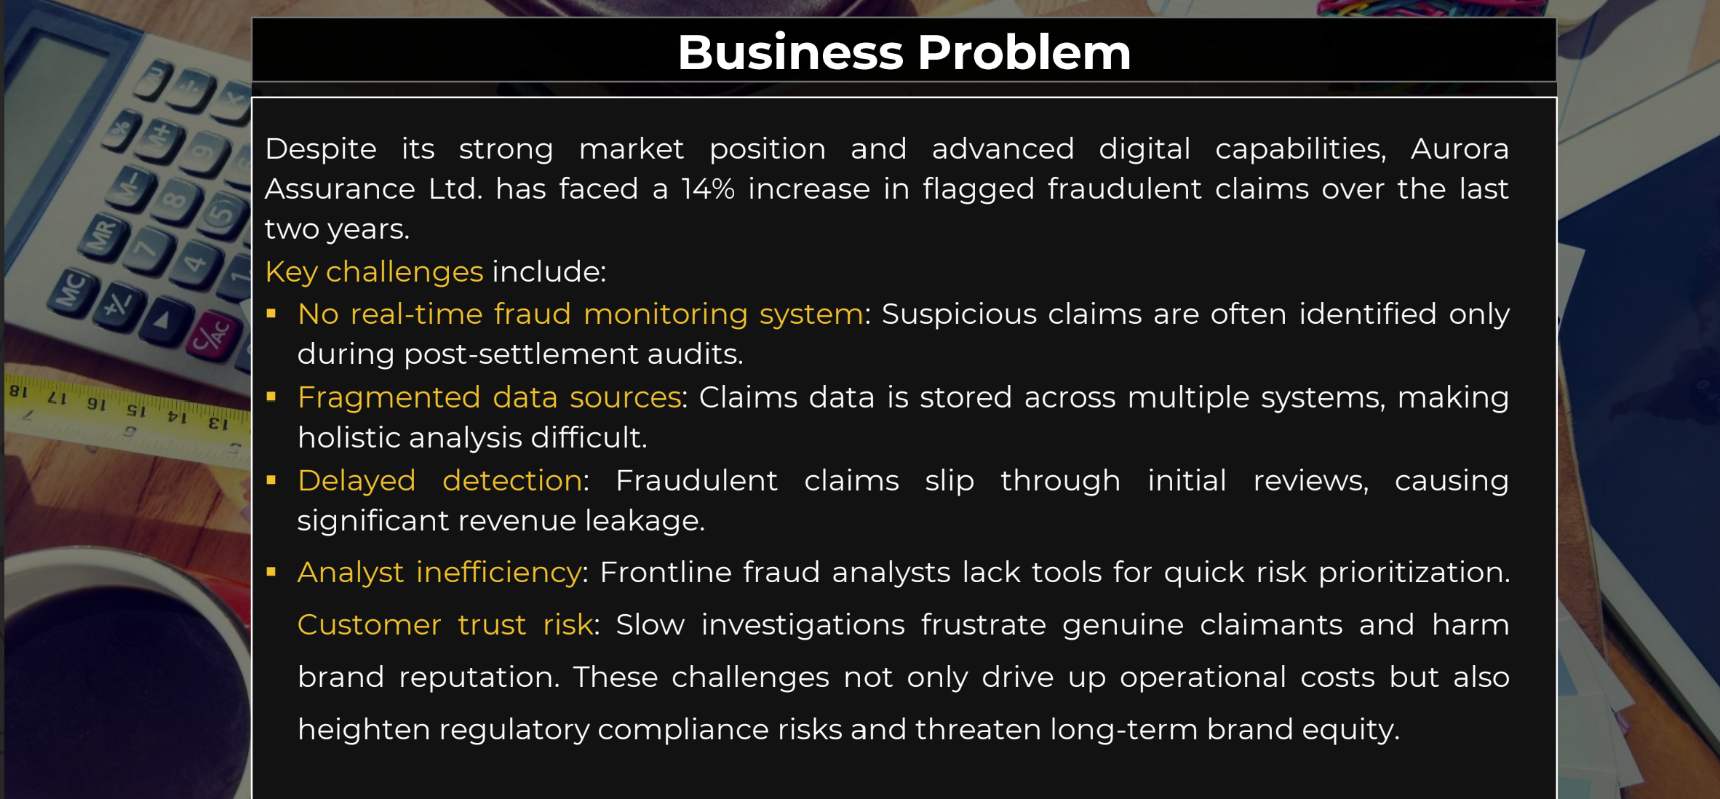

Slide 5
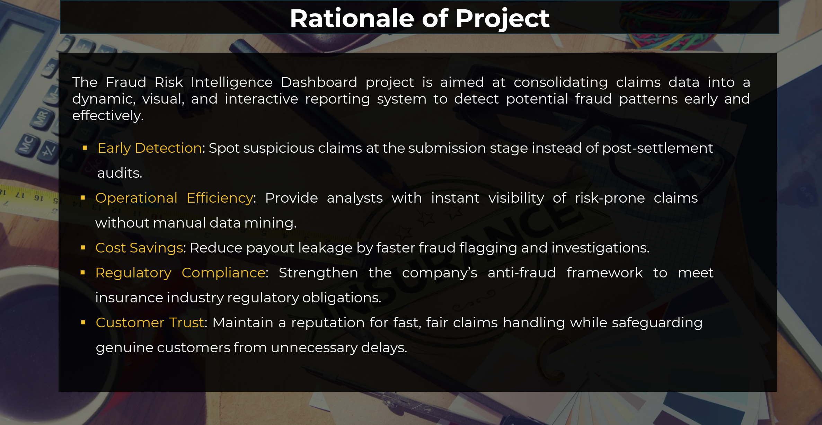

Slide 6
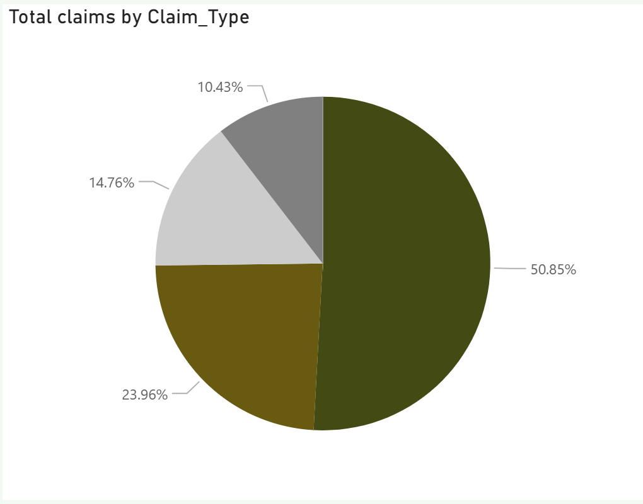
Total Claims by Claim_Type

Slide 7
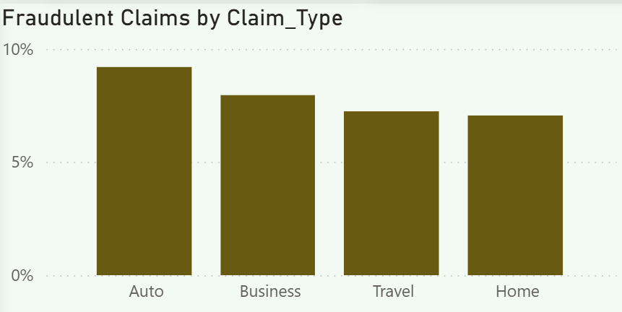
Fraudulent Claims by Claim_Type

Slide 8
Insights-
The total claims of records from AURORA Assurance ltd is 6261 total claims with 22% denied request, 8% fraudulent claims.
The Total claim value at £68M , Total approved fraud at 518, and Average processing time at 23days.
Four (4) Claim Types- Auto, Business, Travel, Home-Auto has the highest fraudulent claim at 9%, business at 8%, Travel and Home at 7%.
Fraudulent Claim for weekend submission True-64.76%
Fraudulent Claim for weekend submission False-35.24%

Slide 9
Impact on Early Intervention on Claim
Customer tenure and Claim Outcomes.
New Customers (0-2) years- 874 claims, 83 flagged as fraud- 9.5%
Long Tenure Customers (10-20) years-2,313 claims, 182 flagged-7.8%
👉 Early intervention: New customers show higher fraud rates → build tighter review rules for them.

Slide 10
Fraud claim by region
Region | Fraud Claims | Fraud Amount (£)
London | 162 | 2,107,117.49
Scotland | 106 | 1,218,060.45
Midlands | 112 | 1,200,407.38
South East | 74 | 749,971.60
North West | 64 | 634,609.53
Wales | 54 | 613,992.59

Slide 11
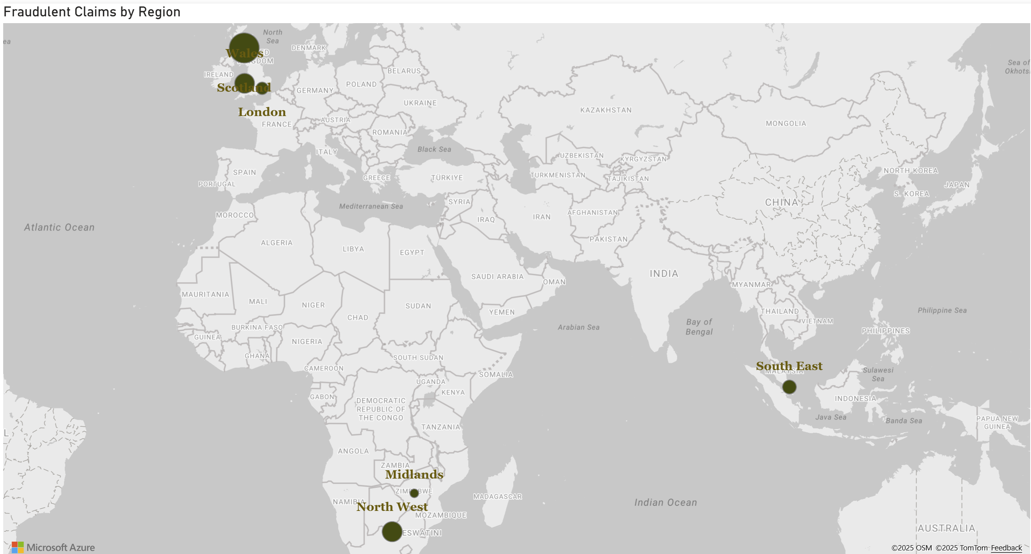
Fraudulent Claim by Region

Slide 12
Fraudulent Claim by Region-Contd…
Fraudulent Claim in Scotland is 10% while other region such as Wales, London, Northwest, Midlands, SouthEast is 8%. This shows that Fraudulent claim was higher in Scotland.

Slide 13
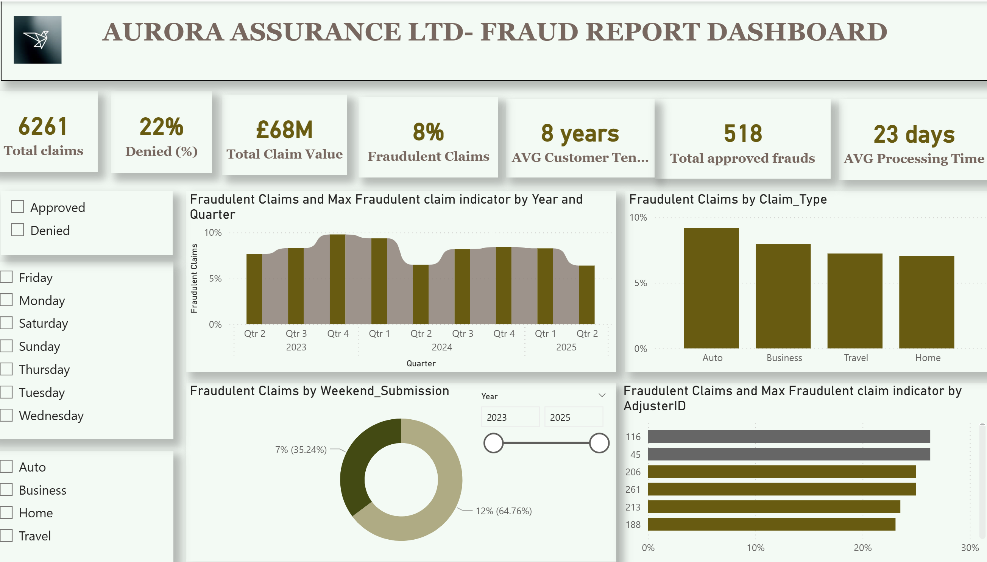

Slide 14
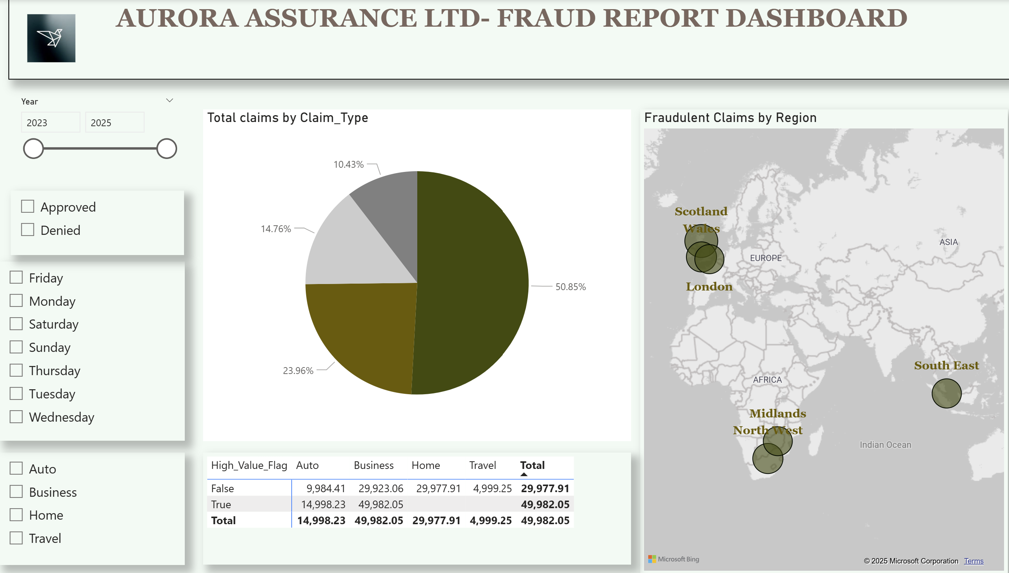

Slide 15
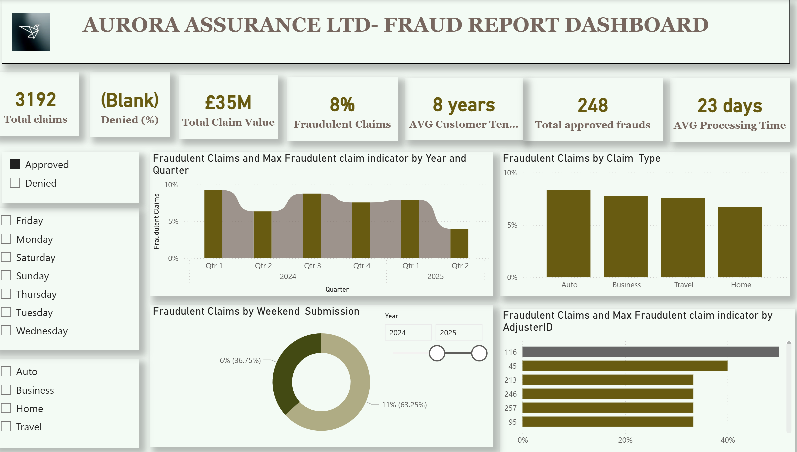

Slide 16
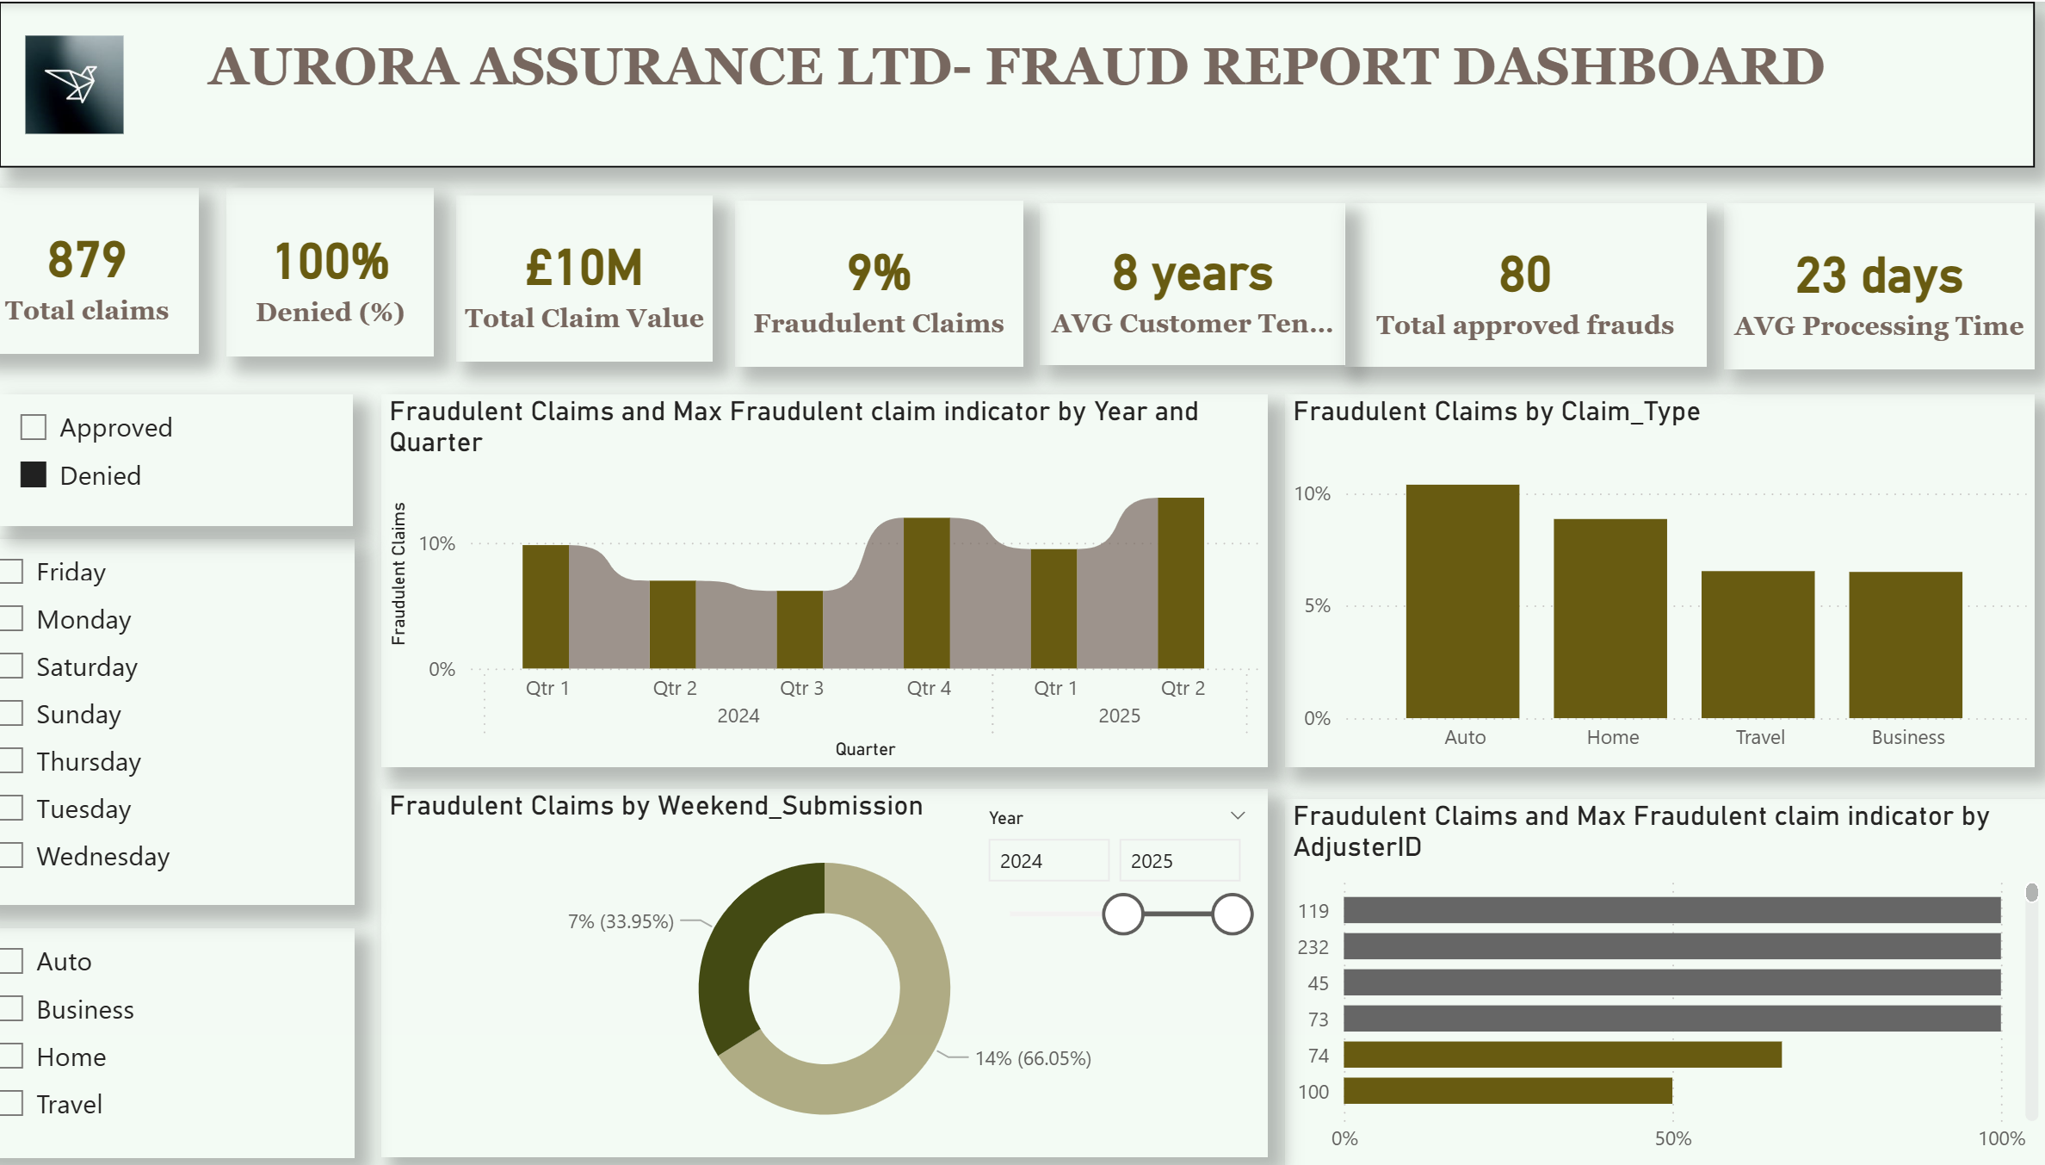

Slide 17
Tenure Group | Total Claims | Fraud Claims | Fraud Rate
0–2 years | 874 | 83 | 9.5%
2–5 years | 1,390 | 109 | 7.8%
5–10 years | 2,423 | 198 | 8.2%
10–20 years | 2,313 | 182 | 7.9%

Slide 18
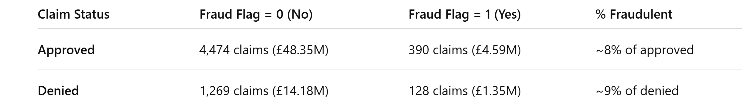
Approved vs Rejected claims with fraud signals

Slide 19
Summary
Faster investigations, early interventions, and improved handling accuracy are achieved when several data-driven and operational factors come together:-
Data quality and accessibility:When the data is clean and complete it will bring about accurate claim amounts, submission dates, and customer history prevent wasted time validating information.
Early warning signals and risk scoring:Fraud indicators- Automated rules to flag unusual claim sizes, duplicate entries, or high-value claims.

Slide 20
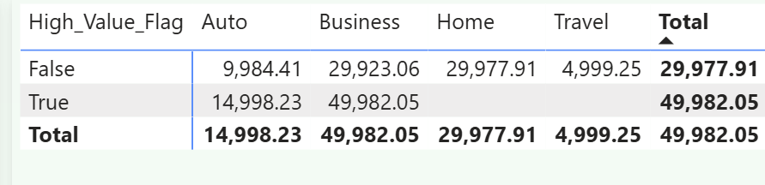
High_Value_Flag Vs Claim Type
Even among approved claims, ~8% (390 cases, ~£4.6M) had fraud indicators.
Denied claims have the highest fraud share (~9%).

Slide 21
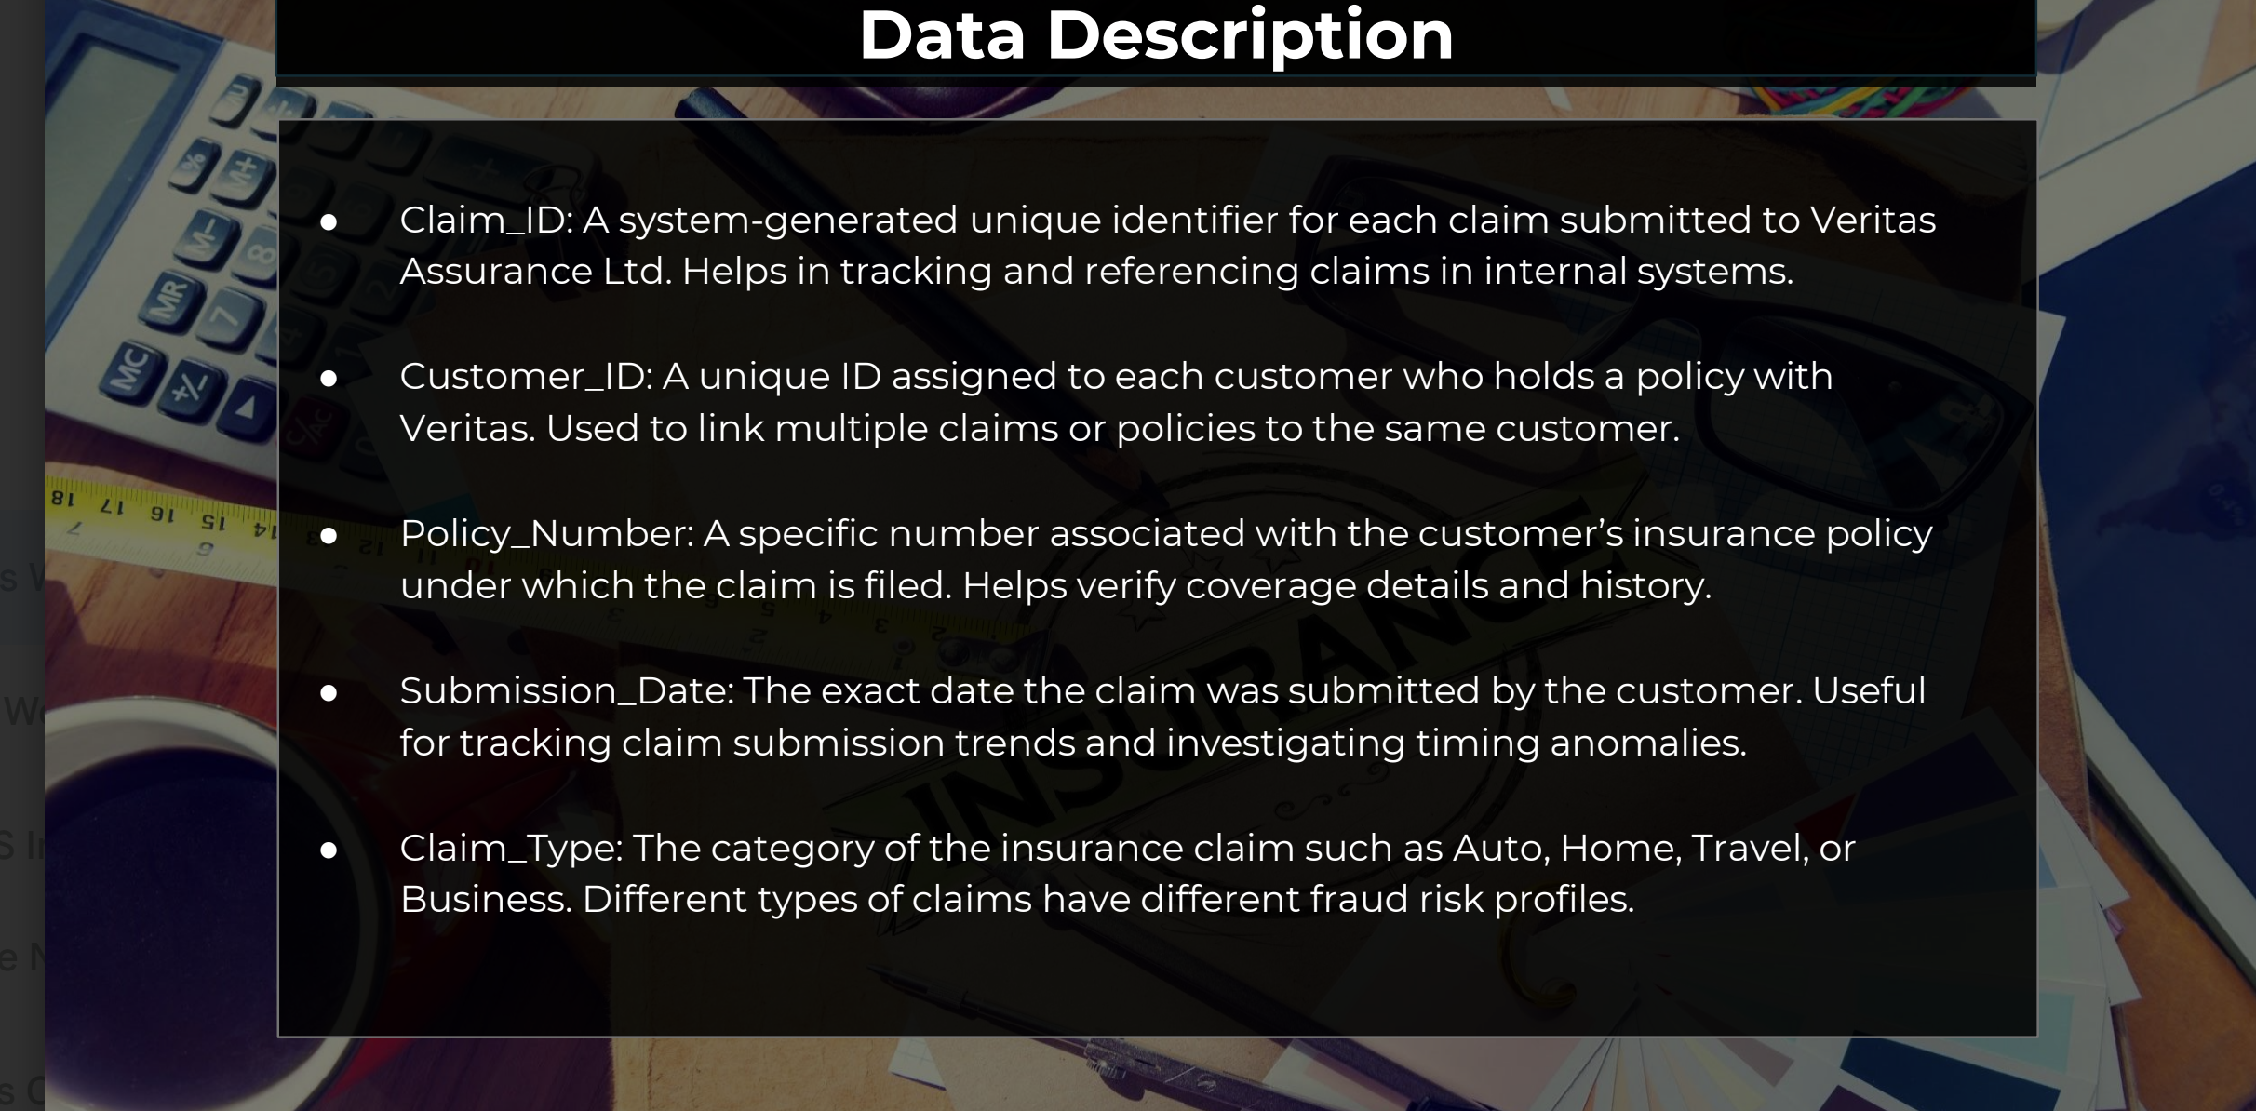

Slide 22
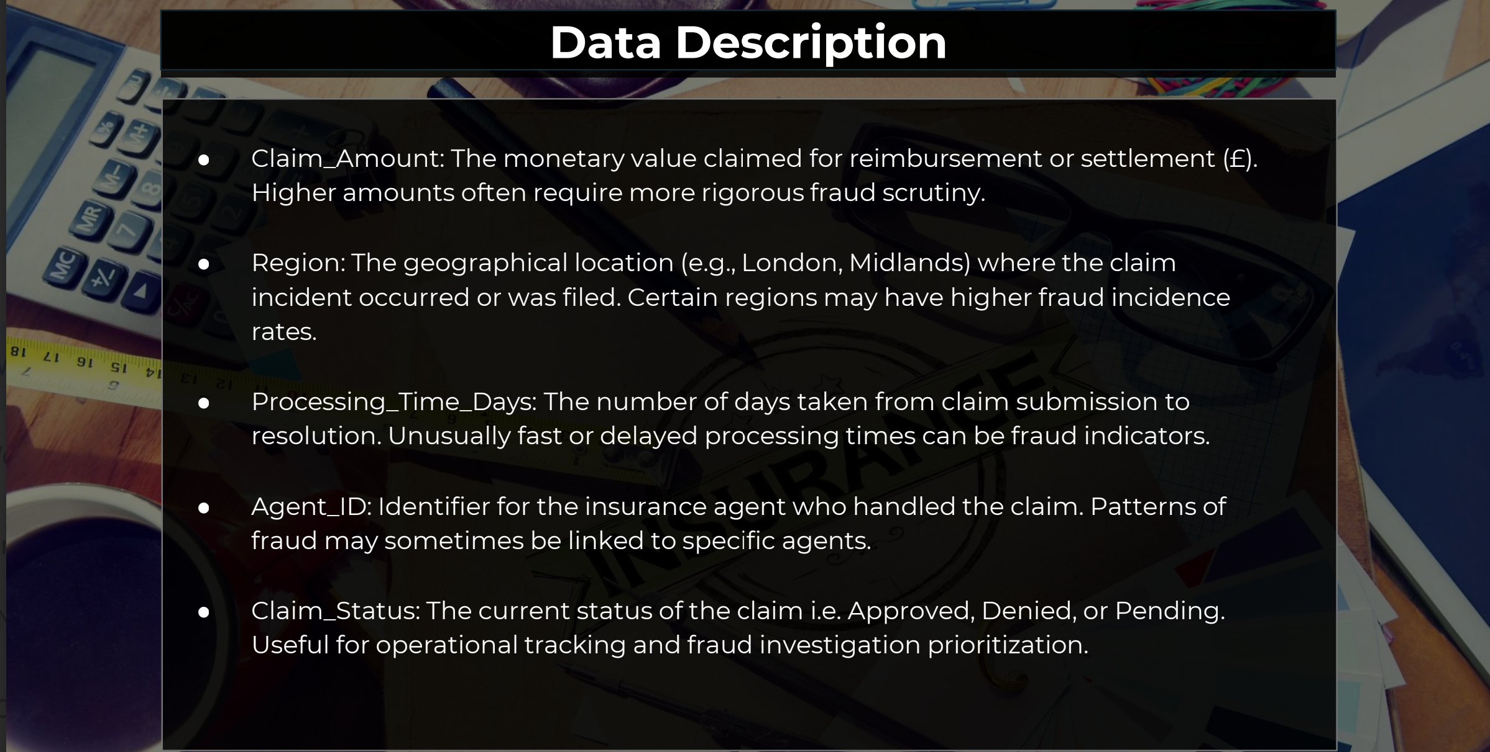

Slide 23
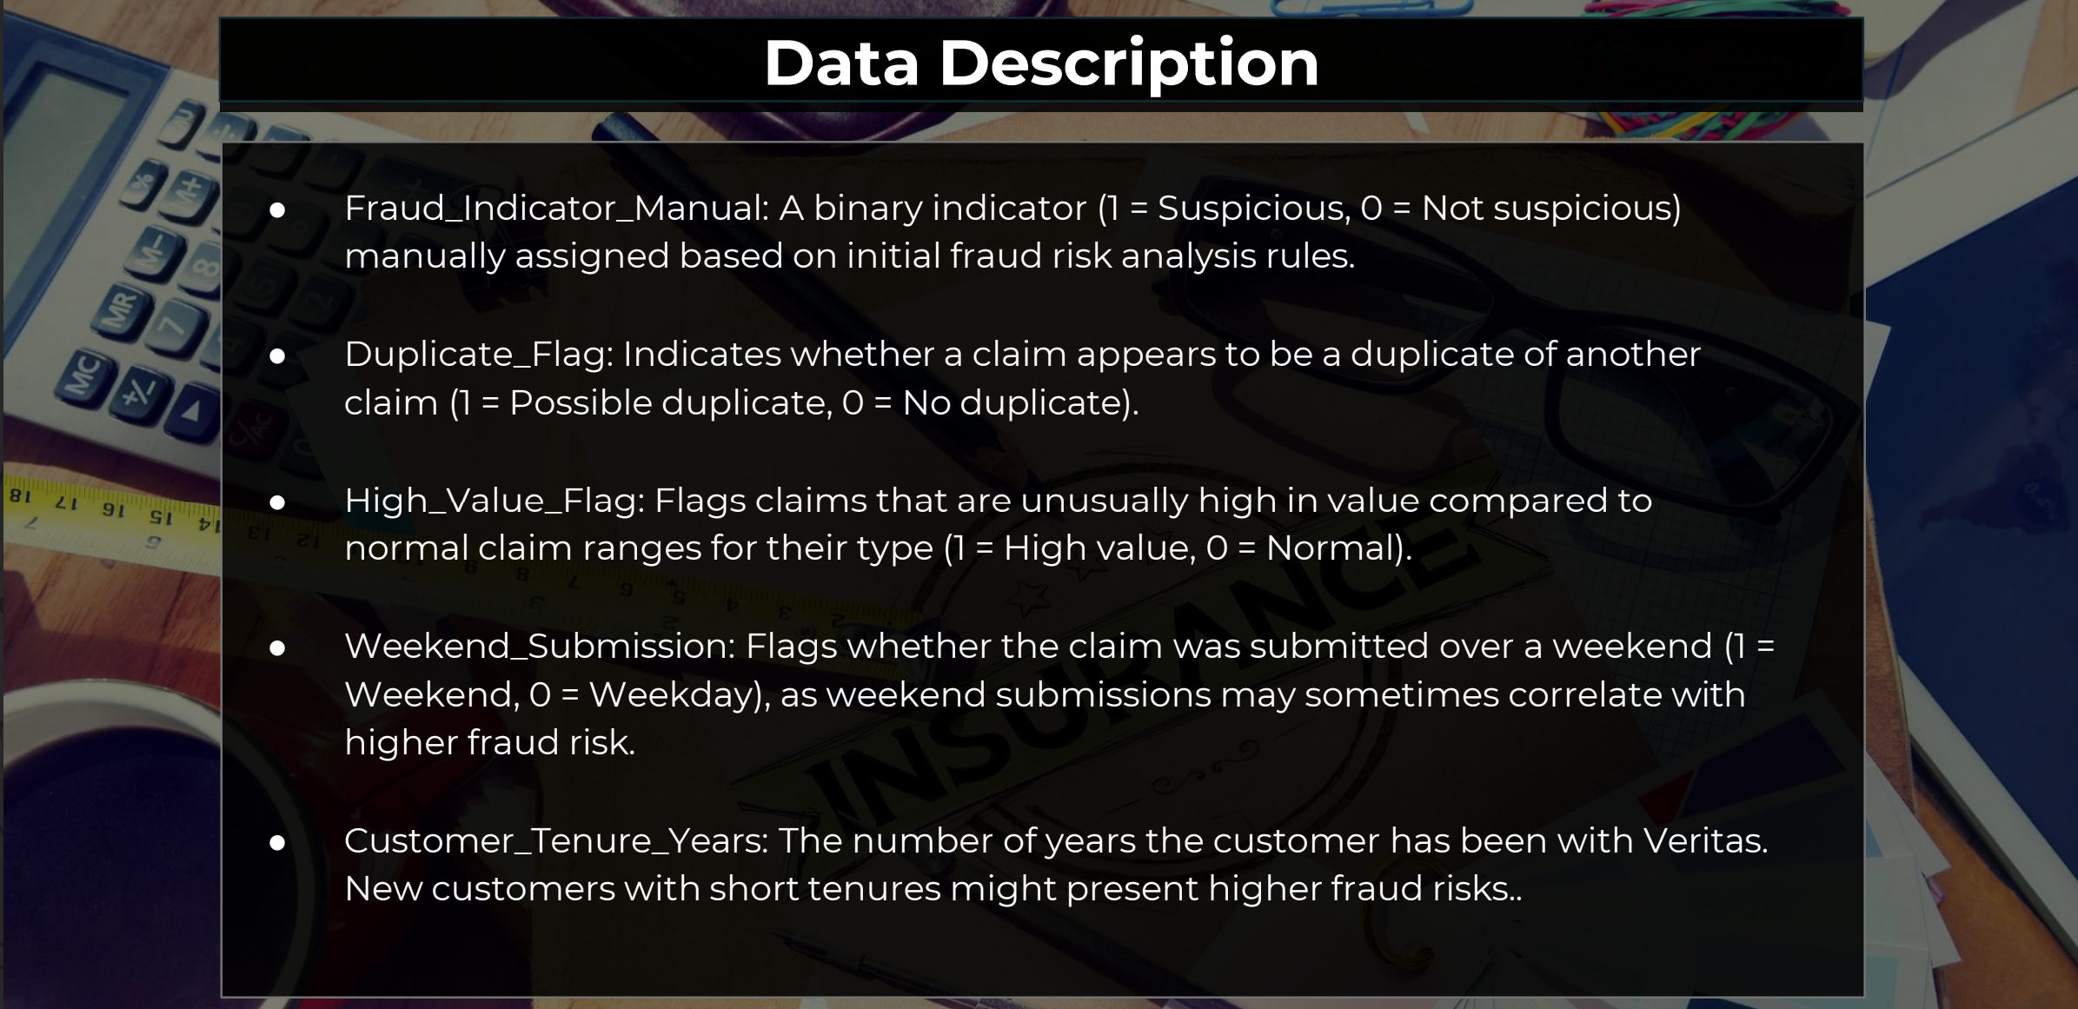

Slide 24
Recommendations
High risk focus-London, Auto claims, and new customers should be prioritized in fraud checks.
Approval accuracy-390 fraud-flagged claims were still approved — review rules and automation thresholds.
Agent Monitoring- Agents with multiple fraud approvals (e.g., AGENT264, AGENT196) need targeted audits or training
Early Interventions- New customers and weekend submissions should be flagged for additional verification.

Slide 25
Thank You

